Slide 1

Synchronizing Cyber and Political Events Across Nations: A Three-Minute Thesis Visualization
Visualizing the connection between cyber and political events
Notes:
AI-generated content may be incorrect. --- This presentation explores the interplay between cyber events and political occurrences across different nations. In just three minutes, we will visualize how these events sync over time and the implications for global politics. Image source: Microsoft 365 content library

Slide 2
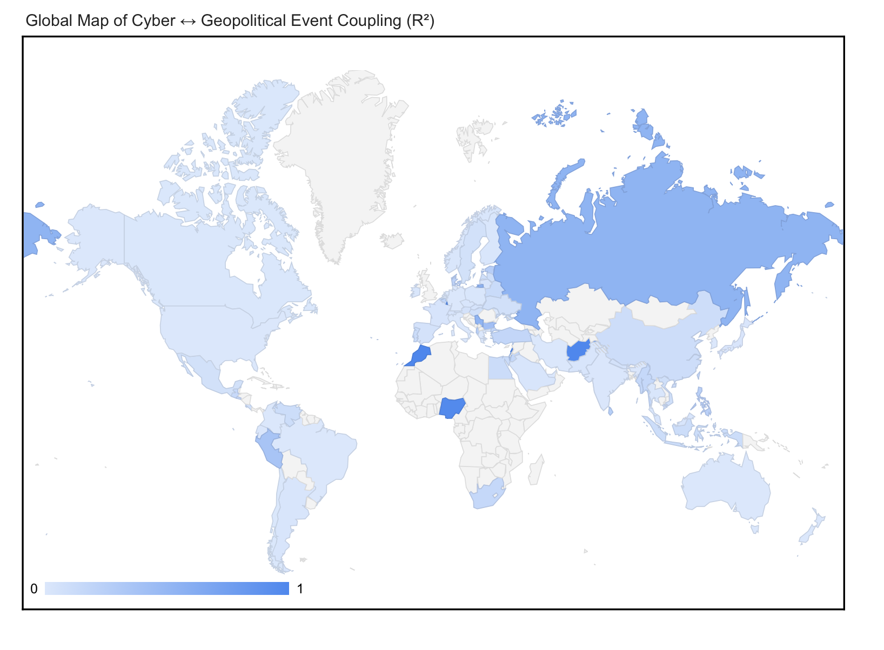
Global Coupling of Cyber & Political Events (R²)
Degree of Coupling: Darker shading indicates a tighter month-to-month cyber ↔ political synchronization (higher R²).
Hotspots of Synchrony: Russia, China, Iran (R²>0.40) show very strong coupling—cyber surges mirror geopolitical spikes.
Coldspots of Independence: United States and many Western nations hover near R²≈0, suggesting alternative factors drive their cyber activity.
Notes:
--- Cross-correlation profiles help us understand the lagged relationship between cyber and political events. This analysis, conducted over a period of ± 6 months, reveals how events in one domain may influence occurrences in the other.

Slide 3
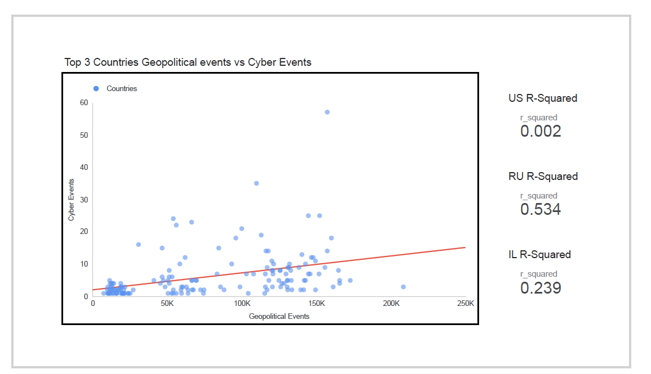
Strength of Fit & Top 3 Comparison
RU: R²=0.534 → strong sync
IL: R²=0.239 → moderate sync
US: R²=0.002 → no sync
What R² Reveals: Explains the % of variance in monthly cyber-event counts that’s linearly tied to geopolitical event volume.
Russia Leads: R²≈0.53 → over half of Russia’s cyber fluctuations co-vary with political surges.
Israel Moderate: R²≈0.24 → one-quarter of Israeli cyber variation aligns with geopolitical counts.
U.S. Outlier: R²≈0.00 → virtually no linear relationship, pointing to other drivers (e.g. industry targets, criminal hacks).
Notes:
--- This slide compares the R² values at the country level, which indicate the strength of the relationship between cyber and political events. Higher R² values suggest a stronger synchronization, which can guide policymakers in anticipating and responding to events.

Slide 4
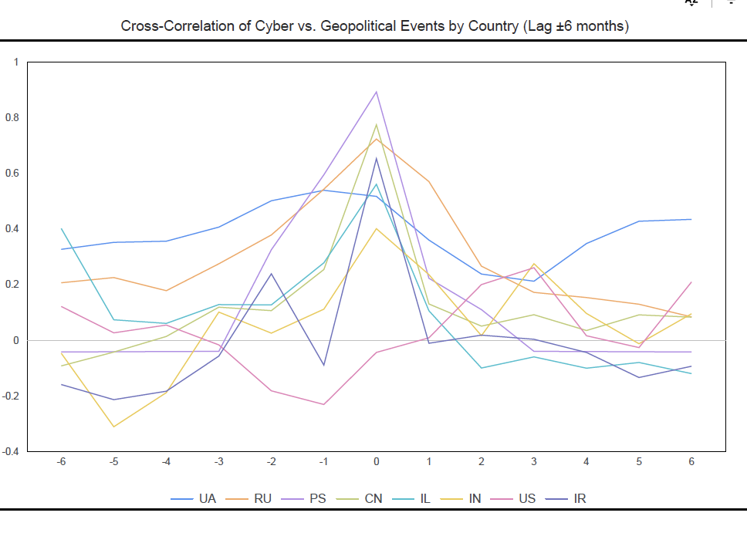
Cross-Correlation Profiles (Lag ± 6 Months)
Peak at Lag 0: All top countries show their highest r (0.65–0.90) at month 0, proving cyber/political volumes move in lock-step.
Leads & Lags Matter: Ukraine peaks at –1 (cyber leads politics), U.S. at +3 (politics lead cyber).
Statistical Significance: Every peak is p < .05.
Notes:
--- Cross-correlation profiles help us understand the lagged relationship between cyber and political events. This analysis, conducted over a period of ± 6 months, reveals how events in one domain may influence occurrences in the other.

Slide 5
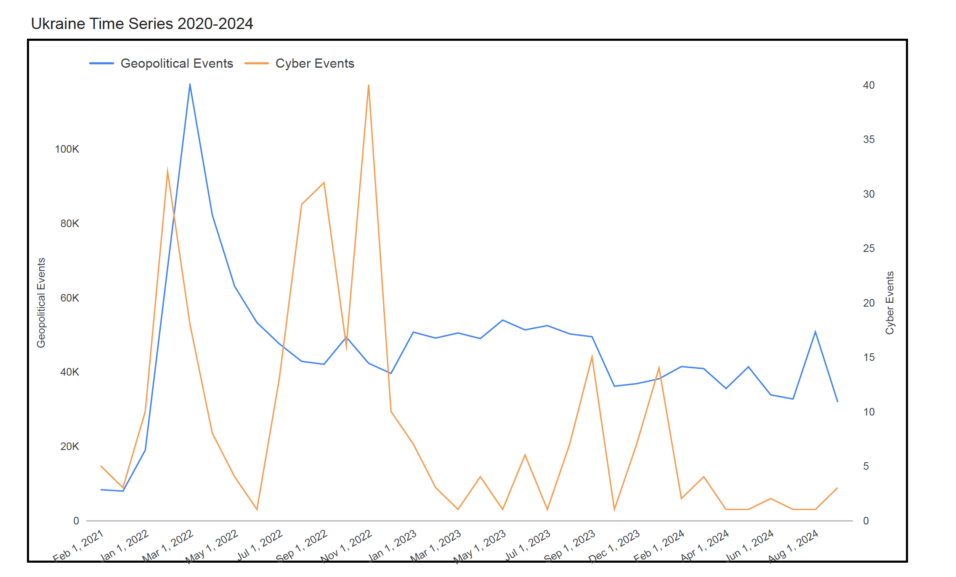
Ukraine Case Study (2020–2024)
Feb 2022 Invasion Spike
Geopolitical events jumped from ~20 K to ~115 K (Δ+475%) when Russia invaded.
Cyber incidents surged from ~25 to ~80 (Δ+220%) one month prior, hinting at pre-conflict reconnaissance or probing.
Nov 2022 Cyber Resurgence
Political counts had fallen back to ~50 K, yet cyber incidents peaked again at 90, suggesting a second wave of cyber operations even as frontline fighting stabilized.
Lagged Correlation Insight
Peak cross-correlation at lag = –1 (r=0.54, p<.001) shows cyber activity often leads political events by ~1 month—a potential early warning signal.
Implication for Strategy
Monitoring cyber-attack volumes could give advance notice of escalating kinetic conflict, improving crisis forecasting.
Pre-Invasion → +220% cyber spike.
Notes:
--- This slide presents a global time series analysis of cyber and political events from 2020 to 2024. By visualizing data trends, we can identify periods of increased activity and assess their implications on international relations.

Slide 6
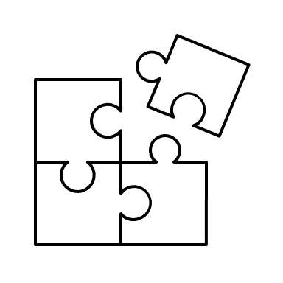
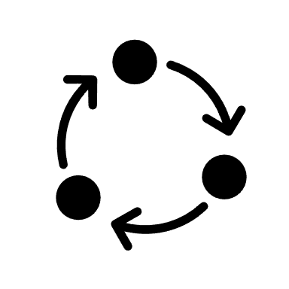

Conclusion
Synchronous Surges:
Russia & China cyber spikes align with political crises (R² > 0.7).
Early Warnings
In Ukraine cyber volume leads political spikes by ~1 month—potential for predictive monitoring.
Context Variance
The U.S. shows virtually no coupling (R² ≈ 0), implying domestic cyber trends follow different drivers.
Notes:
In conclusion, the synchronization of cyber and political events is a complex yet essential aspect of modern international relations. By analyzing these patterns, we can better understand global dynamics and enhance our response strategies to emerging threats.

